Slide 1



Worry-Free
Construction.
COMPANY PROFILE
New Vision Integral
for Maintenance & Contracting
From design and engineering to execution, delivery and maintenance.
Jeddah · Kingdom of Saudi Arabia
www.nvi-sa.com

Slide 2
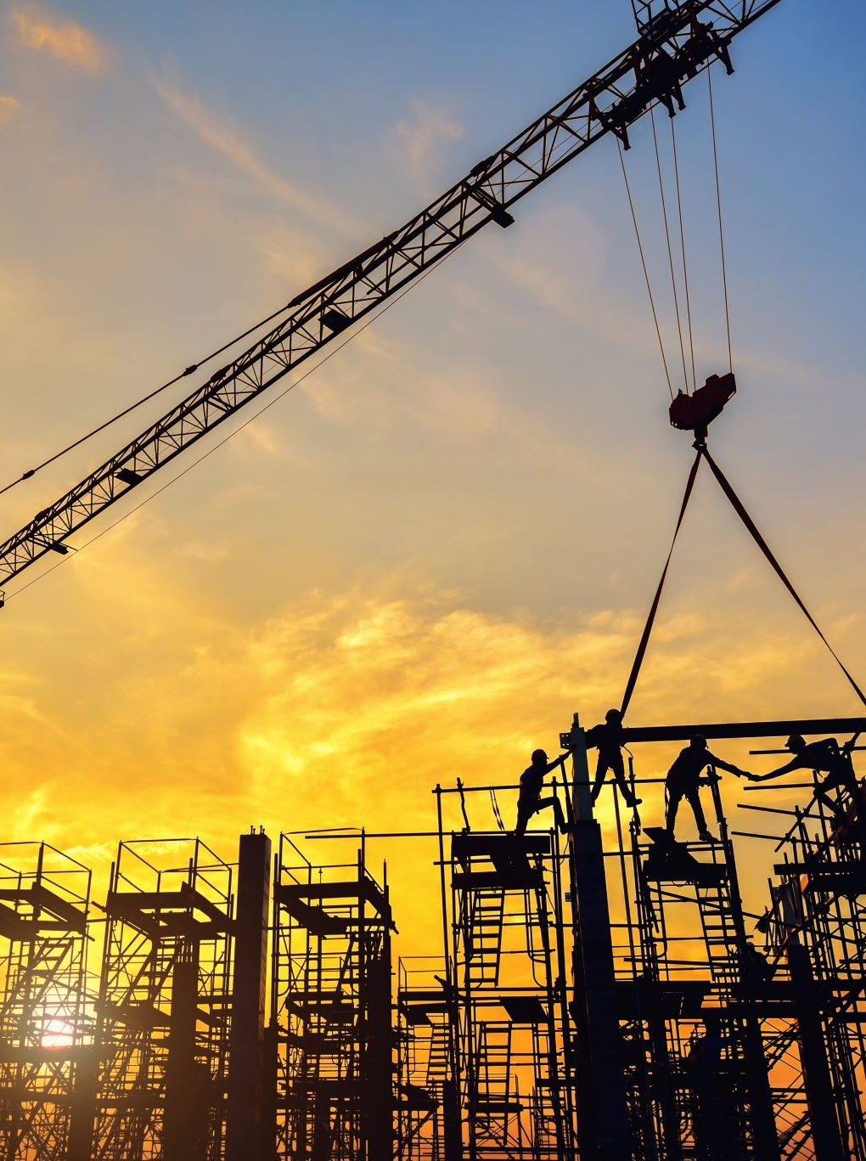
01 · WHO WE ARE
A new Jeddah contractor, backed by 35+ years of expertise.
New Vision Integral for Maintenance & Contracting is a Jeddah-based company established in 2024, providing comprehensive maintenance and contracting solutions tailored to each client's needs.
Our team brings over 35 years of hands-on expertise, and our central Jeddah location lets us serve a diverse range of sectors efficiently.
2024
Jeddah
ESTABLISHED
HEADQUARTERS
35+
8
YEARS OF EXPERTISE
SERVICE LINES
NEW VISION INTEGRAL · COMPANY PROFILE
02

Slide 3

02 · PURPOSE
Vision, mission & values
OUR VISION
OUR MISSION
To become a leading building firm, from creative design solutions and maintenance to execution and delivery, that resolves our clients' social, environmental and economic needs.
To earn our clients' trust and satisfaction, and build long-term relationships through the projects we deliver and maintain.
WHAT WE STAND FOR
Customer satisfaction, never compromised
Integrity & honesty
Effective, principled management
Continuous development
NEW VISION INTEGRAL · COMPANY PROFILE
03

Slide 4




03 · OUR APPROACH
Worry-Free Construction
We don't just build things. We are committed to enhancing people's lives through the built environment. Doing the job properly the first time, with preventive maintenance planned from the beginning, delivers long-term savings for our clients.
01
02
03
04
Accurate Engineering
Detail-Oriented Project Management
Timely Communication
Preventive Maintenance
Getting it right the first time.
Every phase planned, tracked and controlled.
Clients kept informed at every stage.
Planned from day one for long-term savings.
NEW VISION INTEGRAL · COMPANY PROFILE
04

Slide 5
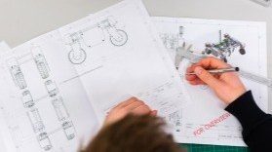

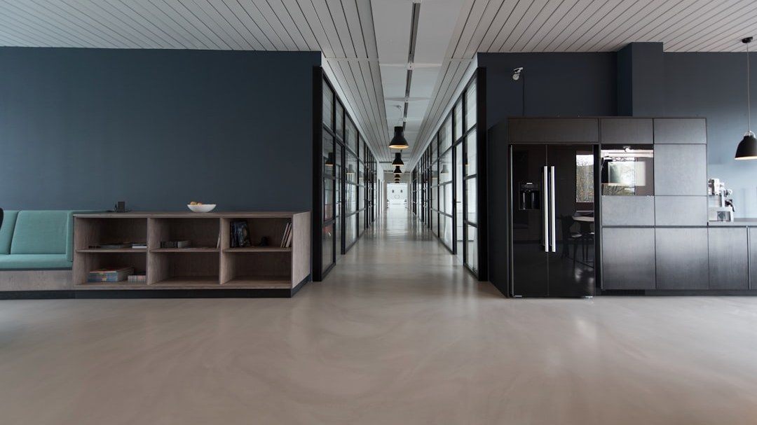
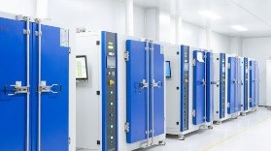
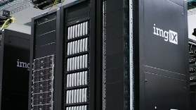
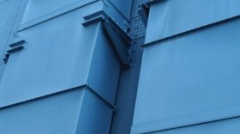
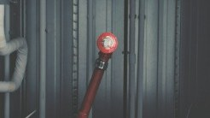

04 · WHAT WE DO
Eight integrated service lines. One accountable partner.
01
Engineering & Planning
02
Contracting & Structure
03
Fit-Out & Finishing
04
Electrical Works
05
Low Current Systems
06
Mechanical & HVAC
07
Plumbing & Fire Fighting
08
Facility Maintenance
NEW VISION INTEGRAL · COMPANY PROFILE
05

Slide 6
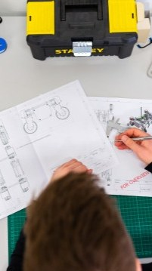
SERVICE 01 / 08
Engineering & Planning
Disciplined project management applied end to end, from feasibility to handover.
01
PHASE 1
Define & Evaluate
02
PHASE 2
Select & Plan
Project definition & characteristics
Portfolio, programme & operations alignment
Business performance & strategic planning
Feasibility study & project evaluation
Commercial vs. governmental profitability criteria
Project selection & project charter
Scope planning & master schedule
Cost, quality & human-resources planning
03
PHASE 3
Control
04
PHASE 4
Execute & Close
Communications, risk & opportunity management
Needs & supplies planning
Analysis methods & change requests
Project phases & their management
Organisation & execution
Closure & project delivery
NEW VISION INTEGRAL · COMPANY PROFILE
06

Slide 7
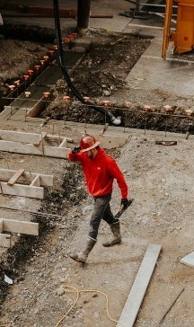
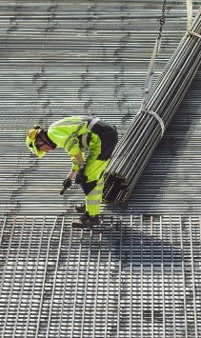
SERVICE 02 / 08
Contracting & Structure Works
Core structural contracting, led by a civil engineer with 35 years' experience, including Saudi Binladen Group.
35
years of civil engineering leadership
Concrete Works
Steel Works
NEW VISION INTEGRAL · COMPANY PROFILE
07

Slide 8
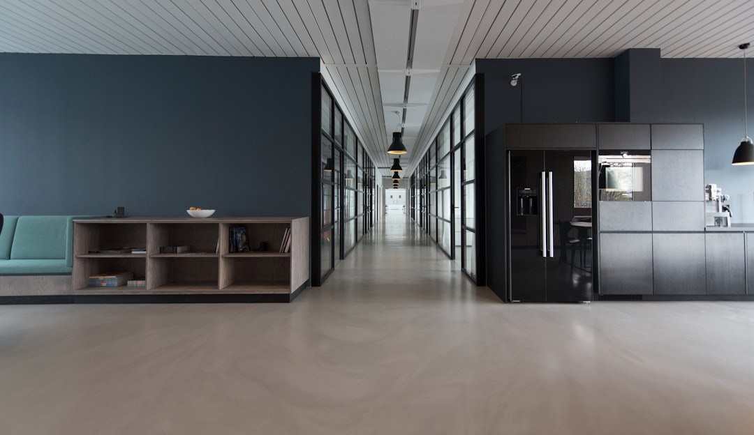


SERVICE 03 / 08
Fit-Out & Finishing Works
Interior design and every finishing trade, delivered under one roof.
Interior design & fit-out
Glass works
Landscaping works
Painting works
Tile works
Gypsum works
Woodworking
Aluminium & metal structures
NEW VISION INTEGRAL · COMPANY PROFILE
08

Slide 9
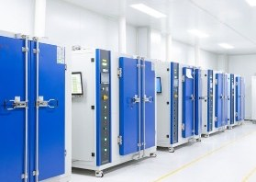

SERVICE 04 / 08
Electrical Works
Complete electrical installation, from main cables to the final point.
01
Lighting fixtures & points
02
Raceways & cabling
03
Power outlets
04
Electrical panels
05
Main cables
06
Grounding & earthing systems
07
Lightning protection systems
NEW VISION INTEGRAL · COMPANY PROFILE
09

Slide 10












SERVICE 05 / 08
Low Current Systems
Data systems
IP telephone systems
Fire alarm systems
CCTV systems
Integrated building systems for data, safety, security and communications.
Public address systems
Nurse call systems
Access control systems
Master clock systems
11
Building management systems (BMS)
IPTV & audio / video systems
Intercom systems
integrated systems, one installer
NEW VISION INTEGRAL · COMPANY PROFILE
10

Slide 11
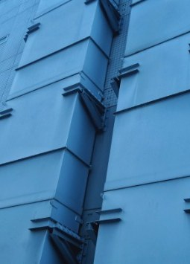




SERVICE 06 / 08
Mechanical & HVAC Works
Cooling, air handling and air distribution systems.
Chillers & package units
Fan coil & air handling units (FCU / AHU)
Ductwork & grilles
Cold & hot water piping
NEW VISION INTEGRAL · COMPANY PROFILE
11

Slide 12
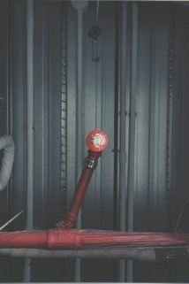


SERVICE 07 / 08
Plumbing & Fire Fighting
Water supply, drainage and fire-fighting networks.
Plumbing
Fire Fighting
Sanitary fixtures
Fire-fighting piping & pumps
Cold & hot water piping
Valves, insulation & fittings
Water & submersible pumps
Fire hose cabinets & sprinklers
Sewage piping
NEW VISION INTEGRAL · COMPANY PROFILE
12

Slide 13







SERVICE 08 / 08
Buildings & exterior façades
01
Facility Maintenance
Interior decoration
02
Preventive maintenance, planned from the beginning, to protect our clients' investment over the long term.
Electrical works
03
Low-voltage systems
04
Networks & CCTV
05
Mechanical works & air conditioning
06
Plumbing works
07
NEW VISION INTEGRAL · COMPANY PROFILE
13

Slide 14

05 · CLIENTS
Trusted by established brands
A selection of the clients we have delivered for.
CLIENT
CLIENT
CLIENT
DUKAN
PANDA
MAZDA
Savola Group
Haji Husein Alireza & Co. Ltd.
NEW VISION INTEGRAL · COMPANY PROFILE
14

Slide 15
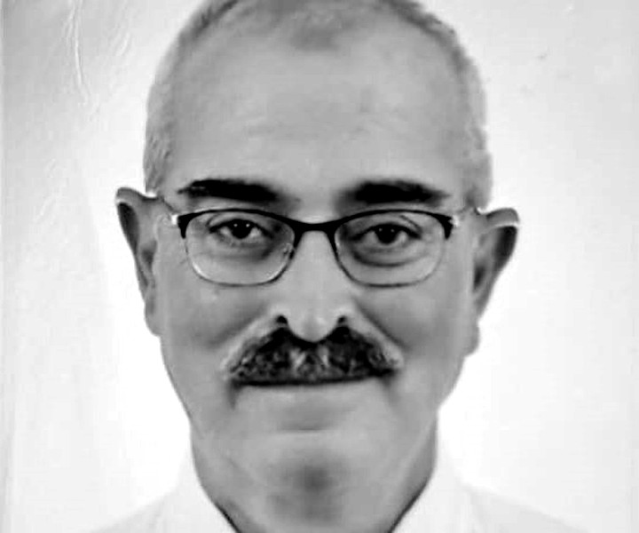
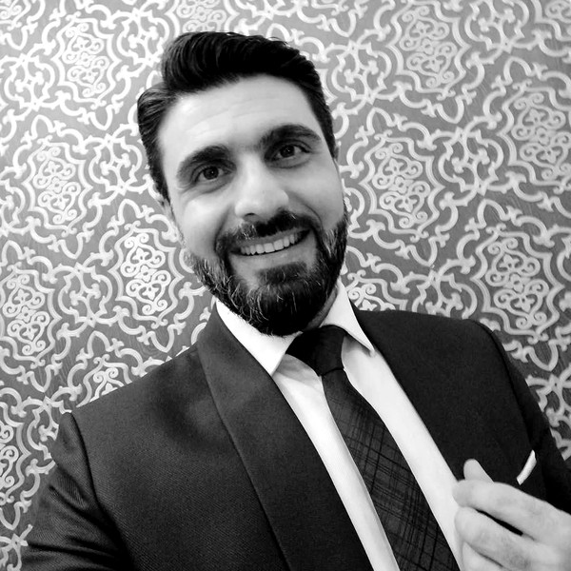
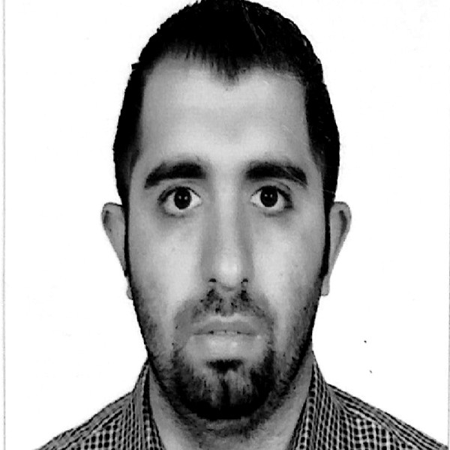
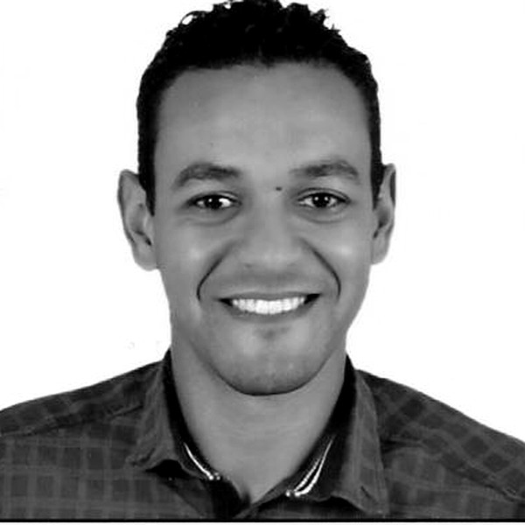
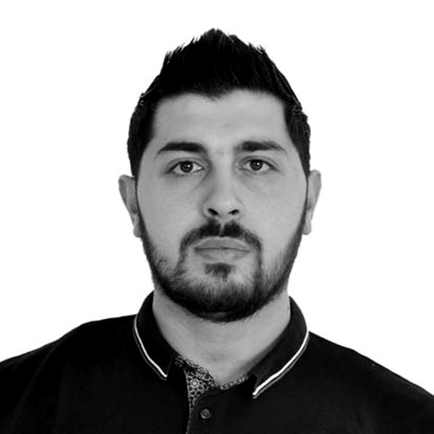
06 · LEADERSHIP
Experienced engineers across every discipline
PROJECT MANAGER
PROJECT MANAGER
Hazem Ghorbal
Mohammad Khayat
Interior Designer
Network Engineer
18
years' experience
15
years' experience
PROJECT MANAGER
PROJECT MANAGER
GENERAL MANAGER
Nader M. Abdulhadi
Anas Khayat
Azzam Al Sayeh
Electrical Engineer
Mechanical Engineer
Civil Engineer · 35 years' experience, including Saudi Binladen Group
11
years' experience
5
years' experience
NEW VISION INTEGRAL · COMPANY PROFILE
15

Slide 16





07 · CONTACT
Let's build, worry-free.
New Vision Integral for Maintenance & Contracting · Jeddah, Kingdom of Saudi Arabia
GENERAL MANAGER
SALES MANAGER
ONLINE
Azzam Al Sayeh
Abdulhai Hambrouch
www.nvi-sa.com
a.alsayeh@nvi-sa.com
a.ahmed@nvi-sa.com
+966 50 597 6970
+966 55 069 6190
NEW VISION INTEGRAL · COMPANY PROFILE
16

